Slide 1
building better healthcare for low-income Californians
Presenter: Gary Langer
Langer Research Associates
langerresearch.com
@LangerResearch

Slide 2
BSCF research overview
Research aims:
help safety net facilities navigate changes brought about by the ACA
identify cost-effective paths to primary care redesign
determine the motivators of patient satisfaction, empowerment and efficacy; identify strategies to achieve them
Work to date:
in-depth statewide random-sample surveys in 2011, 2012 and 2013
four major reports to date, two pending
briefing papers, blog reports, multiple presentations to practitioners, policymakers and other stakeholders

Slide 3
2011 research summary
baseline study of the healthcare experiences and preferences of low-income Californians
prime focus: motivators of patient satisfaction and loyalty
findings for follow-up:
strong desire for a direct relationship with a provider
substantial hesitation to engage in shared decision making

Slide 4
2012 research summary
dig more deeply into patient-provider relationships and the drivers of patients’ engagement in their care
key finding: expressed preference for a traditional doctor-patient model in fact reflects desires for connectedness and continuity in care experiences
most low-income Californians currently lack connectedness and continuity
both can be created through non-traditional models including team-based care and healthcare coaches, and most are open to trying these models
data-driven model establishes how connectedness, continuity and information drive patient empowerment and ultimately active participation in healthcare decision making
continuity – the frequency you see the same healthcare provider when you have medical appointments
connectedness – feeling like someone at your facility knows you “pretty well”

Slide 5
a model of patient engagement 2012 BSCF survey of low-income Californians
empowerment:
feel informed about your health
comfortable asking provider questions
connectedness
engagement
continuity
provider usually explains things in a way you understand
confident you can make healthcare decisions
Notes:
Controlling for other factors, the results of this survey show that connectedness and continuity predict “empowerment”
outcomes – feeling well-informed, being comfortable asking questions of care providers, understanding providers’ answers
and being confident in the ability to make healthcare decisions. Feeling well-informed also independently predicts the
other three empowerment items. And each of the empowerment measures predicts “engagement,” that is, taking a role
in healthcare decisions – a key goal of patient-centered care.

Slide 6
2013 research goals
delve more deeply into the power of information and patient-provider communication in primary care redesign
how do patients obtain their health information, how would they like to obtain it?
how do they assess their current communication with their care providers?
what’s their use, and interest in using, technology-based information and communication for health purposes?
how do new approaches to health information and patient-provider communication interact with interest in alternative care strategies?
(Add sample of higher-income Californians for comparison)

Slide 7
methodology
representative statewide telephone survey, May 2- June 8, 2013, among a random sample of 1,530 Californians age 19-64, including:
1,018 respondents with household family incomes below 200 percent of the federal poverty level (matching previous research)
498 Californians with household family incomes at or above 200 percent of the federal poverty level (new to this study)
819 landline and 711 cell phone interviews
1,196 interviews conducted in English, 334 in Spanish

Slide 8
part 1: health information, sources & trust

Slide 9
key findings
information is an essential component of a virtuous cycle that produces stronger patient-provider relationships and an empowered, engaged and satisfied patient population
a broad gap currently exists between the information patients possess and what they desire to make good medical decisions
desire for greater information is similar across socioeconomic lines
fewer than half currently rely on doctors as their top source of health information; as many rely on media sources
information from medical sources is much more highly trusted
trust in doctors is especially high among patients whose providers explain things clearly and invite questions
patients who use alternative care strategies are more likely to feel informed, to rely on doctors as their primary source of information and to trust medical sources of information

Slide 10
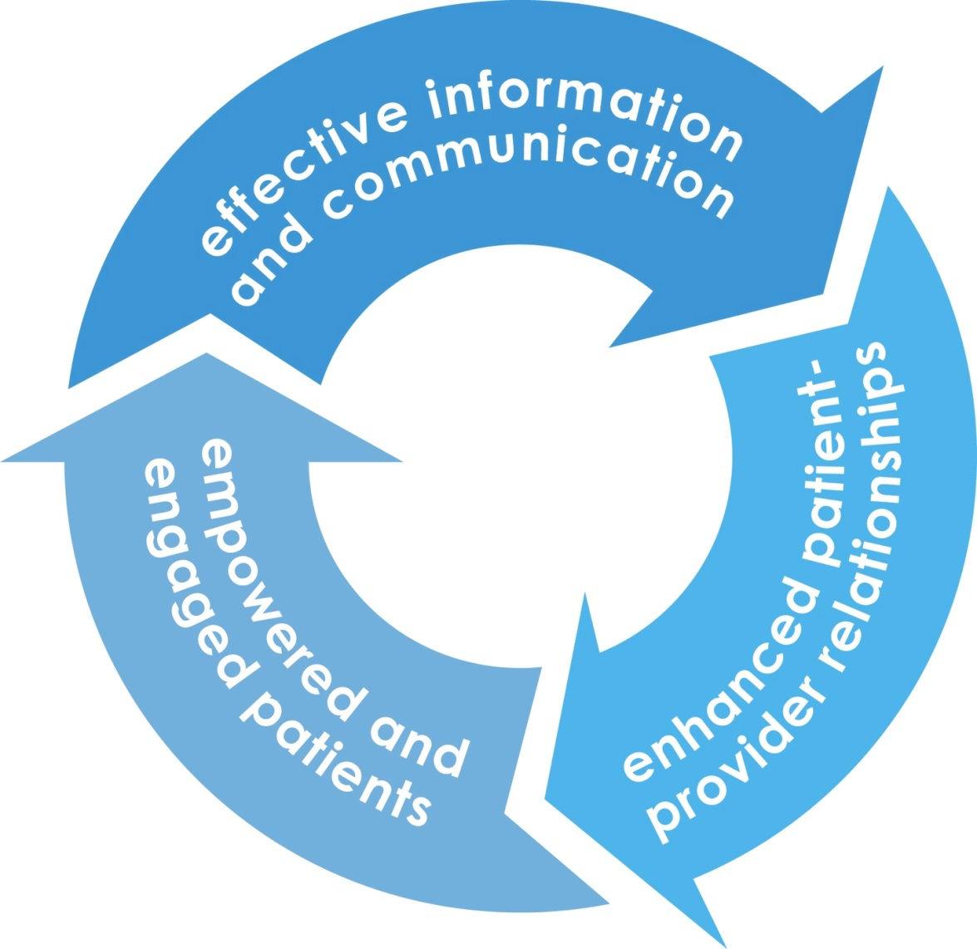
information is essential

Slide 11
desire for clear, accessible information
overall

Slide 12
desire for clear, accessible information
if information were clear and easily accessible

Slide 13
top source of health information
Notes:
note: use of the internet for health information is not a problem per se – as we note later, it can be beneficial, and help facilitate patient-provider relationships. but it can be problematic for patients to use the internet as their top source of health information, especially if it’s by necessity (i.e., because patients don’t have a provider they trust), not by choice. using the internet because you are urged to by providers, and having providers’ guidance and feedback on information culled from the internet. is much different than relying solely on unvetted (often untrusted) internet sources because you have no other choice

Slide 14
trust in health information sources
Notes:
the % for health coaches/websites/apps are among those who have/use them.

Slide 15
top information source and the desire for more clear information

Slide 16
the impact of alternative care and communication models
% who feel they need more info to make the right decision:
Notes:
Note: Portal user refers to people who say their facility has a portal, who have internet access, and who don’t say they’ve never used it

Slide 17
the impact of alternative care and communication models
% who feel very informed about their health
Notes:
Note: Portal user refers to people who say their facility has a portal, who have internet access, and who don’t say they’ve never used it.

Slide 18
the impact of encouragement on information levels

Slide 19
part 2: communication and the patient-provider relationship

Slide 20
key findings
while information is a necessary component of shared decision making, communication is critical for the patient-provider relationship to work
low-income Californians rate their relationship with their providers positively overall, but there is clear room for improvement
virtually every key outcome is predicted by the quality of patient-provider relationships: satisfaction with care, trust in medical professionals, confidence, empowerment and engagement
top predictors of positive patient-provider relationships:
feeling informed about one’s health
having care providers who encourage an active role
having as much of a say in health decisions as desired
connectedness
using alternative care strategies and tools
Notes:
By “using alternative care strategies and tools” in the last bullet point of the blue box, we mean:
- having team based care
- extent of current health tech usage index (this includes using internet/apps for info/advice/tracking/etc., as well as communicating with providers via text/email)
- having used a decision aid
- having a healthcare coach.

Slide 21
patient-provider index
the extent patients feel their provider cares about them
how frequently they feel their provider explains things clearly and asks them if they have any questions or concerns
how comfortable they feel asking providers questions, telling providers about outside health info and disagreeing with providers’ recommendations
how simple or complicated they feel the health information they’ve received from their providers has been
how much of a say they feel they currently have in decisions about their care
can range from 1 (very negative) to 4 (very positive), avg = 3.16
Notes:
Even though average score is pretty positive – there’s still plenty of room for improvement. Just 6% score a perfect 4, and more than a third score below three (a less than positive score)

Slide 22
impact of patient-provider relationships on information
patient-provider relationship:
Notes:
Weak vs. strong = Above vs. below average.

Slide 23
impact of patient-provider relationships on reliance and trust
patient-provider relationship:
Notes:
Weak vs. strong = Above vs. below average.

Slide 24
impact of patient-provider relationships on overall healthcare experiences
patient-provider relationship:
Notes:
Weak vs. strong = Above vs. below average.

Slide 25
predicting the patient-provider index
patient-provider relationships are positively predicted by:
feeling informed about one’s health
having care providers who encourage an active role
having as much of a say in health decisions as desired
connectedness
primary language: English
use of alternative approaches
facilities that focus on these can improve patients’ relationships with their provider – with the positive benefits that follow
use of alternative approaches includes:
having team-based care
extent of current use of health information and communication technology, including:
using internet/apps for information, advice, reminders, tracking, etc.
communicating with providers via text/email
having used a decision aid
having a healthcare coach
Notes:
Contrary to concerns that healthcare technology may be off-putting or encourage information overload, the model suggests it (as well as other alternative approaches) can help advance patient-provider communication, not detract from it.

Slide 26
part 3 alternative approaches to care, communication & information gathering

Slide 27
key findings
alternative approaches can reduce burdens on providers while enhancing patient information and communication
the digital divide is a challenge given the many low-income Californians who lack internet access or texting phones
while very few now use the internet/apps for health information purposes or have access to a patient portal, many are interested
relatively few communicate with providers via text or e-mail, but those who do overwhelmingly find it useful and among the rest interest again is high
there’s broad interest in non-tech approaches such as decision aids, healthcare coaches and team-based care
interest in new approaches is mainly driven by a desire for more information
Notes:
re: first bullet point, “alternative approaches” includes both tech and non-tech based strategies/tools.

Slide 28
the digital divide

Slide 29
% lacking internet access

Slide 30
use of online health information
Notes:
predicts PPI in index. Also predicts feeling very informed.

Slide 31
current (lack of) use of internet/apps for health reasons
% of internet users who have used the internet or an app to:
Notes:
In index, predicts PPI and is correlated with feeling informed and (negatively) with wanting more information.

Slide 32
interest in using internet/apps for health reasons
% of internet users who are interested in using the internet/apps to:
Notes:
a regression predicting an index of these six items shows that the strongest independent predictor, by far, is the desire for more information.

Slide 33
does your facility have a patient portal?
among all low-income Californians
Notes:
Does not predict PPI, but (as shown in chart earlier) predicts feeling very informed and satisfaction with current information. Specifically, portal users are more apt to feel very informed about their health than non-users (by a 22 pt margin) and 10 pts less likely to feel they need more information to help them make better decisions, and among those who have used them, 92% find them useful

Slide 34
% interested in a patient portal
among internet users without one
Notes:
NET = 74% interested, 25% not interested.

Slide 35
current tech-based communication with providers
among those who can (i.e., have a texting phone or internet access)
Notes:
Predicts PPI.

Slide 36
current tech-based communication with providers
among those who can (i.e., have a texting phone or internet access)
Notes:
Predicts PPI.

Slide 37
% interested in asking health questions via:
(among those who have the necessary technology, but currently can’t)
texting with providers
e-mailing with providers

Slide 38
use of other alternative approaches

Slide 39
interest in other alternative approaches

Slide 40
conclusions
We find broad untapped potential for use of the internet and software applications for healthcare information and communication
while very few low-income Californians currently use these resources, interest in doing so is high
the digital divide is compounded by the fact that many safety net facilities lack tech-based tools
non-tech-based models of caregiving also show great promise in enhancing information sharing and communication
a majority of low-income Californians are open to team care, healthcare navigators, and decision aids; all are beneficial to patient information and patient-provider relationships
providers’ active encouragement of patient engagement can have a profound benefit across a variety of outcomes

Slide 41
recommendations
increase the use of alternative care approaches that can improve patient-provider relationships and increase patients’ information
these include team-based care, healthcare coaches, decision aids, technology-based information and communication tools
many can be deployed cost-effectively
encourage patients to take a greater role in their care
stress to providers the need to encourage patient involvement and to focus on effective communication
improve patients’ access to high-quality, accurate and easily understood health information:
create or enhance patient portals to give patients access to relevant, provider-approved information
enable and communication via text or e-mail
Improved patient-provider relationships result; empowerment, efficacy and satisfaction follow

Slide 42
Thank you!
Presenter: Gary Langer
Langer Research Associates
langerresearch.com
@LangerResearch

